Slide 1
Mini Popper | Colt poppers | Pepper poppers | Plates | Wall feet
2 | 4 | 2 | 2 | 61
Bay | Stage | Target Type | Count | NS | Total | Hard Cover
A3 | Derrick Penwood | USPSA | 8 | 2 | 10 | 2 Tux 2 Right Diag
A2 | Plinko | IPSC | 32 | 2 | 34 | 2 Tux 2 Right Diag
B1 | Heads or Tails | IPSC | 8 | 0 | 8
B2 | A-Maze-ing | USPSA | 27 | 1 | 28 | 1 Tux 1 Right Diag
B3 | Short Fuse | IPSC | 22 | 0 | 22
B4 | CM 99-33 | USPSA | 12 | 2 | 14 | 1 Tux 1 Left Diag
Target Type | HC Type | Count
IPSC | Tux | 2
IPSC | Left Diag | 0
IPSC | Right Diag | 2
IPSC | 50.00% | 0
USPSA | Tux | 4
USPSA | Left Diag | 1
USPSA | Right Diag | 3
USPSA | 50.00% | 0

Slide 2
Prop | Stage
Swinger x2 | Stage 3, B1
Swinger | Stage 4, B2
Red Stitch, door | Stage 5, B3
Table | Stage 6, B4

Slide 3

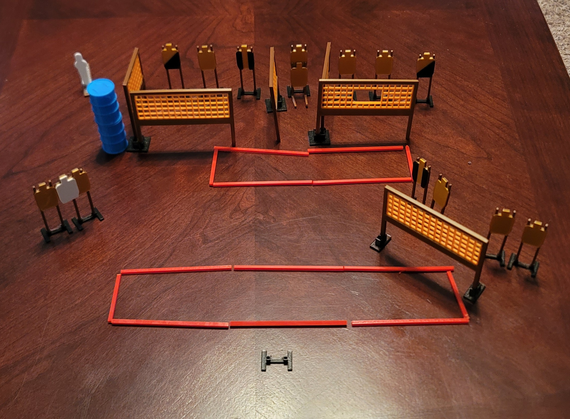
 | Dothan Practical Shooters – USPSA Match Derrick Penwood Course Designer : Eric Henwood Bay: A3
Round Count 29 rounds 14 USPSA 1 colt popper
Equipment List 10 wall feet 12 targets (10 + 2 NS) 2 right diag, 2 tux

Slide 4
Derrick Penwood
Written Stage Briefing
Scoring: Comstock Rounds: 29
Targets: 14 USPSA, 1 steel
Handgun start position: feet on X’s, wrists below belt. Handgun is loaded and holstered.
PCC start position: feet on X’s, stock on belt. Loaded carbine is held with both hands, stock on belt.
Stage Procedure: on the audible start signal, engage targets as they become available from within the shooting area.

Slide 5
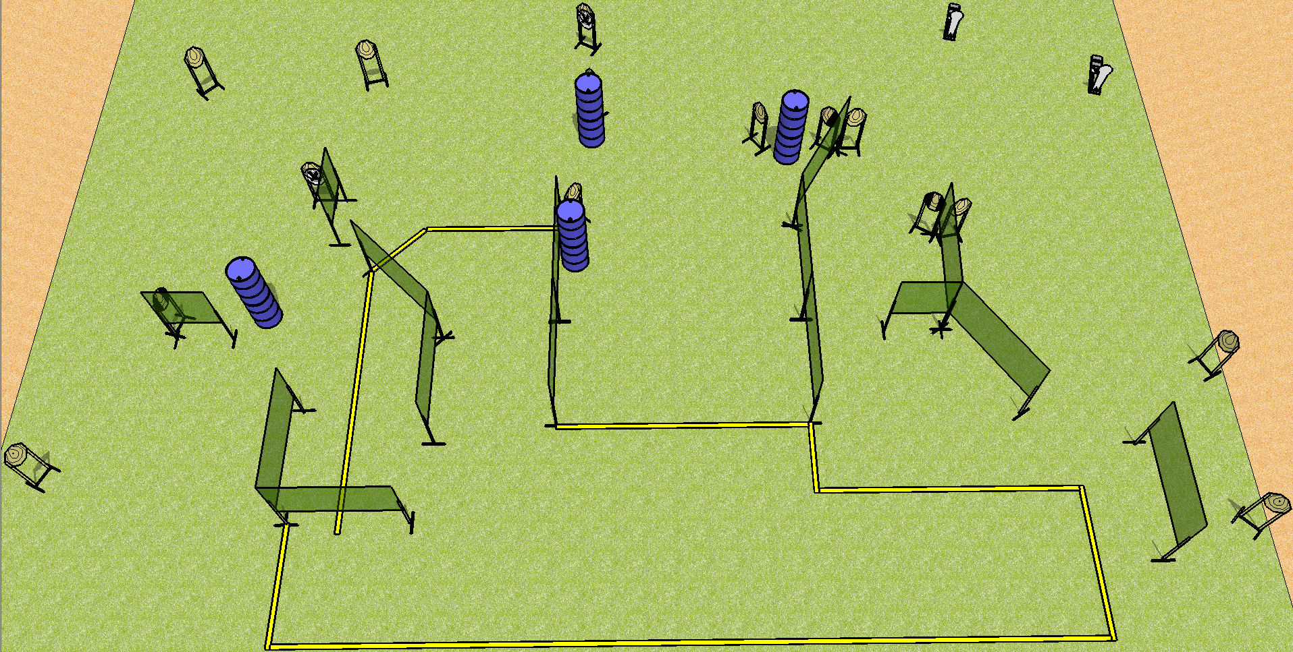
 | Dothan Practical Shooters – USPSA Match Plinko Course Designer : Drew Coleman Bay: A2
Round Count 32 rounds 15 IPSC 2 colt poppers
Equipment List 26 wall feet 13 targets (11 + 2NS) 2 tux, 2 right diag
Right Diag

Slide 6
Plinko
Written Stage Briefing
Scoring: Comstock Rounds: 32 rounds
Targets: 15 IPSC, 2 colt poppers
Handgun start position: anywhere inside the shooting area, wrists below belt. Handgun is loaded and holstered.
PCC start position: anywhere inside the shooting area, stock on belt. Loaded carbine is held with both hands, safety on.
Stage Procedure: On the audible start signal, engage targets as they become available from within the shooting area.

Slide 7
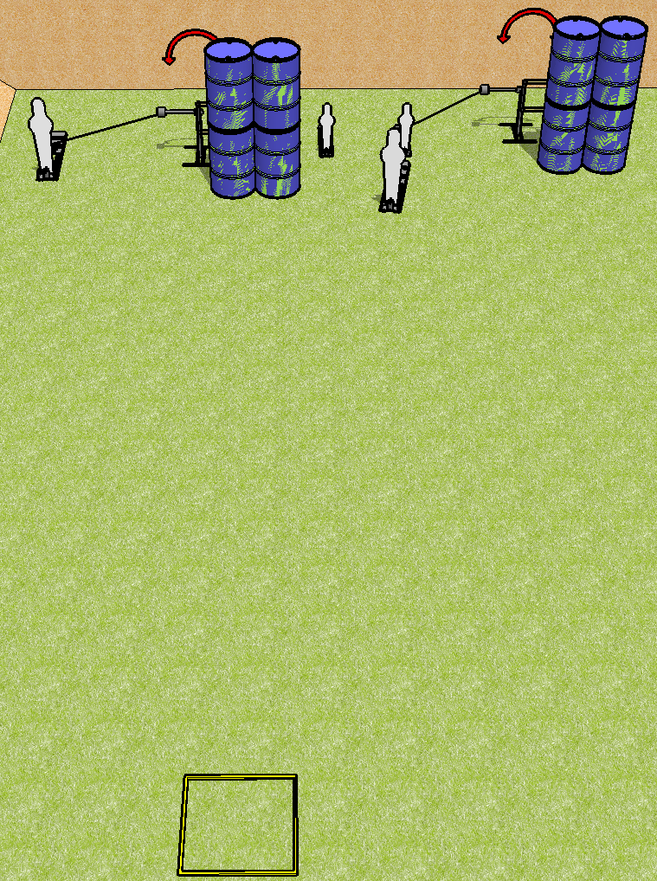
 | Dothan Practical Shooters – USPSA Match Heads or Tails Course Designer : Drew Coleman Bay: B1
Round Count 8 rounds 2 paper 2 pepper poppers, 2 mini poppers
Equipment List 2 swingers + activators Shooting box

Slide 8
Heads or Tails
Written Stage Briefing
Scoring: Comstock Rounds: 8
Targets: 2 IPSC, 4 steel
Handgun start position: inside shooting area, wrists below belt. Handgun is loaded and holstered.
PCC start position: Inside shooting area, stock on belt. Loaded carbine is held with both hands, safety on.
Stage Procedure: on the audible start signal, engage targets as they become available from within the shooting area. T1 is activated by P1, T2 is activated by P3, both remain visible at rest.

Slide 9
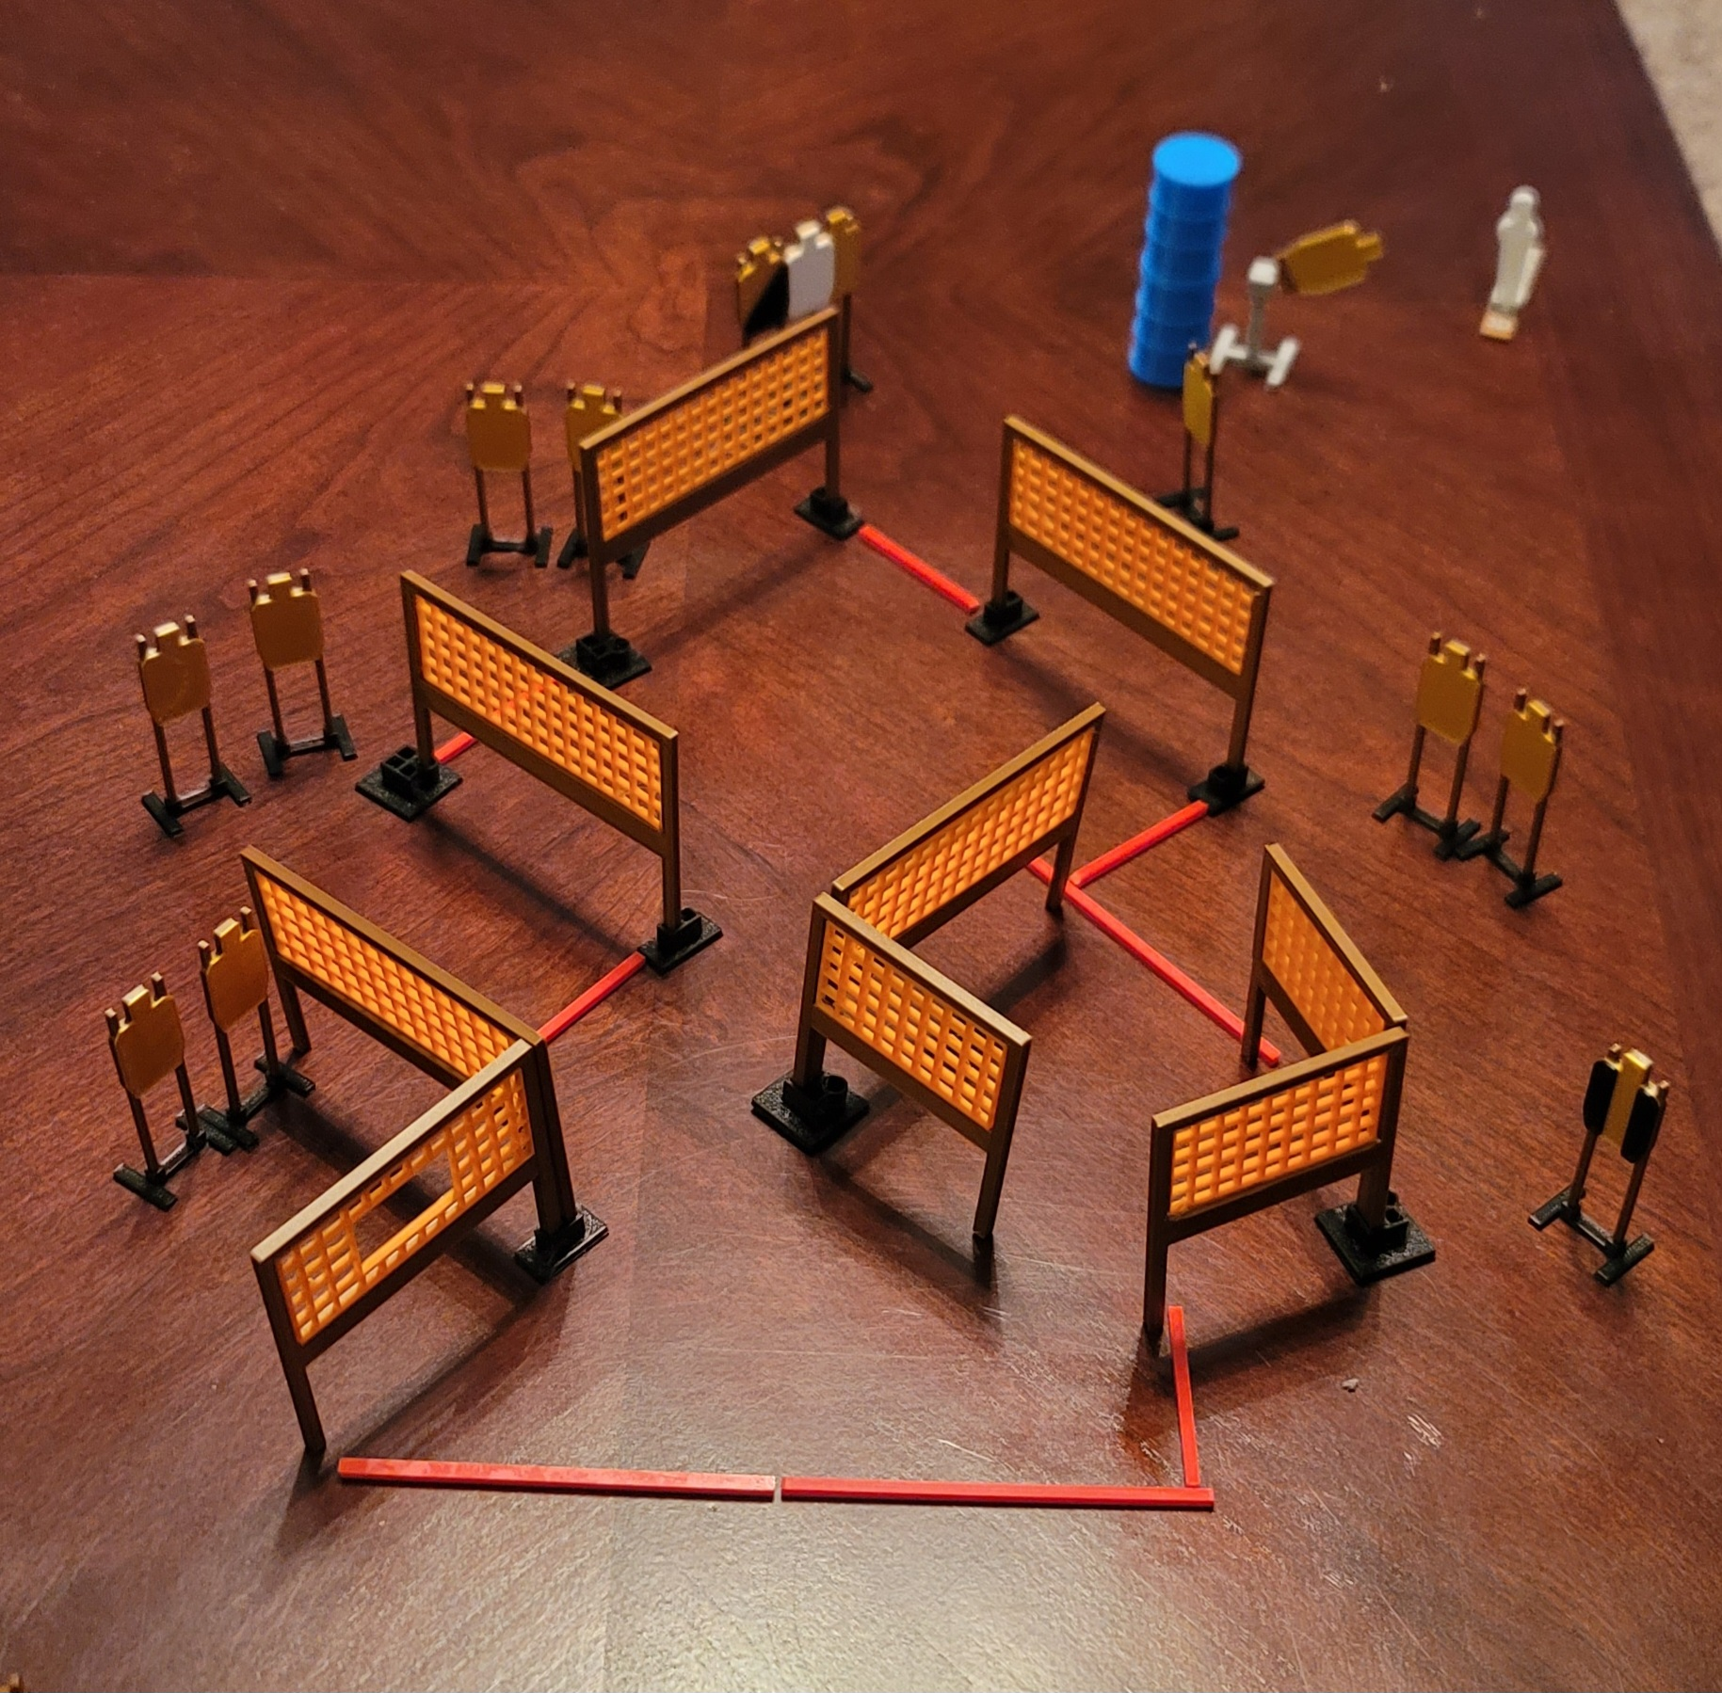
 | Dothan Practical Shooters – USPSA Match A-Maze-ing Course Designer : Eric Henwood Bay: B2
Round Count 27 rounds 13 USPSA 1 colt popper
Equipment List 15 wall feet 12 paper (11 + 1 NS) 1 tux + 1 right diag Swinger + activator

Slide 10
A-Maze-ing
Written Stage Briefing
Scoring: Comstock Rounds: 27
Targets: Comstock
Handgun start position: hands touching marks, loaded and holstered.
PCC start position: muzzle touching either mark, stock on belt. Loaded carbine is held with both hands, safety on.
Stage Procedure: on the audible start signal, engage targets as they become available from within the shooting area. The swinger is activated by P1 and remains visible at rest.

Slide 11
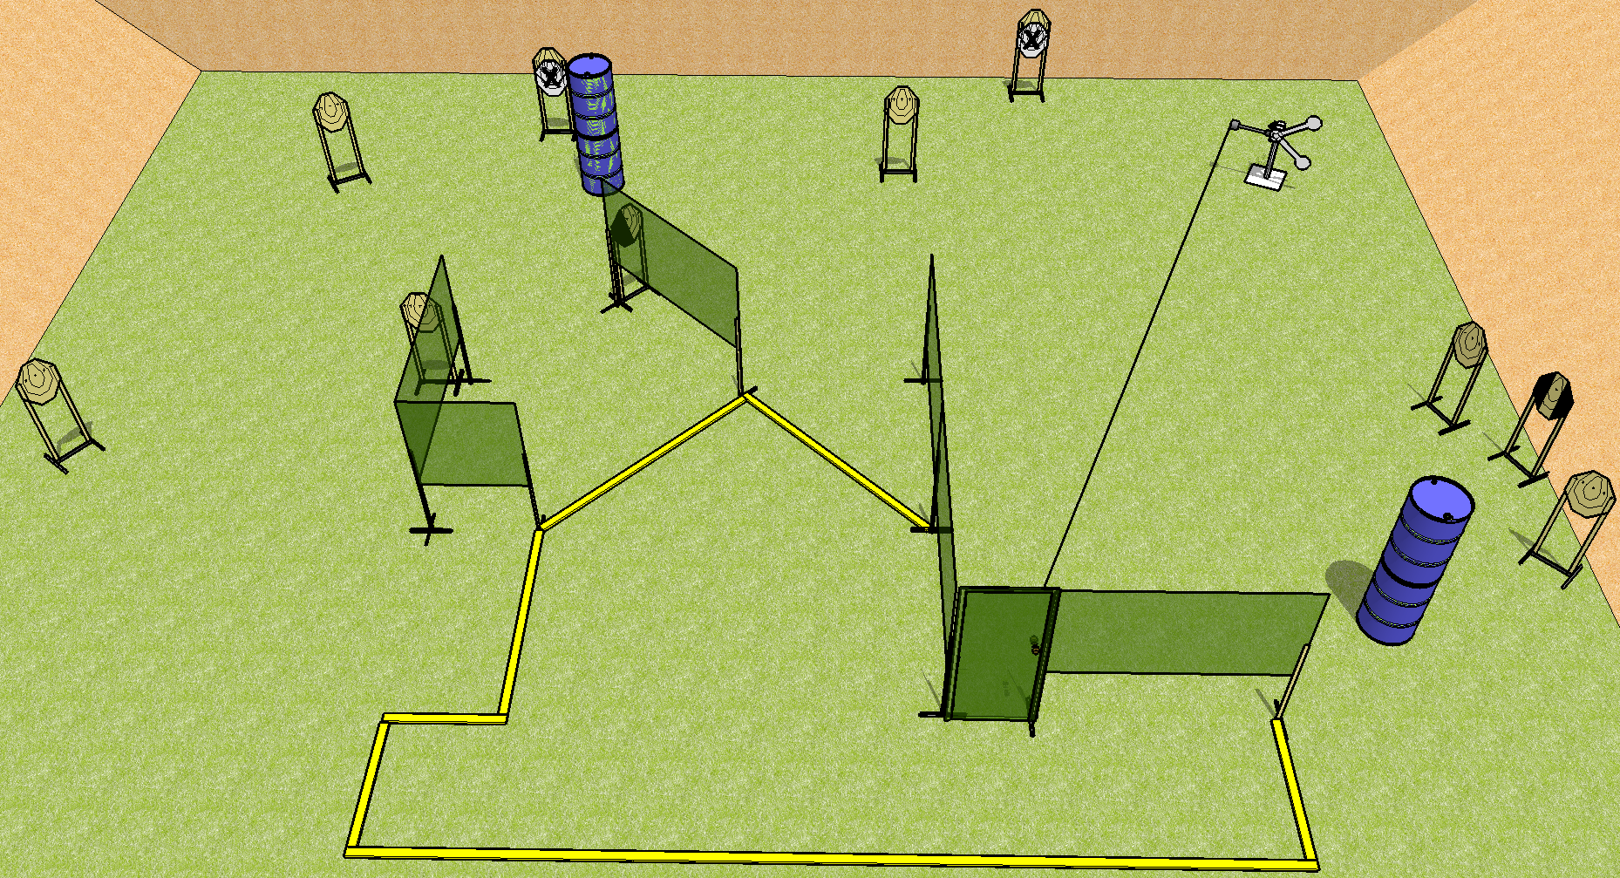
 | Dothan Practical Shooters – USPSA Match Short Fuse Course Designer : Drew Coleman Bay: B3
Round Count 22 rounds 10 IPSC 2 plates
Equipment List Red stitch swinger + activator + door 10 targets (8 + 2NS) 1 tux, 1 left diag
X x

Slide 12
Short Fuse
Written Stage Briefing
Scoring: Comstock Rounds: 22
Targets: 10 IPSC, 2 steel
Handgun start position: feet on X’s, wrists below belt. Handgun is loaded and holstered.
PCC start position: feet on X’s, stock on belt. Loaded carbine is held with both hands, safety on.
Stage Procedure: On the audible start signal, engage targets as they become available from within the shooting area. The plate swinger is activated by the door and remains visible at rest.

